Slide 1
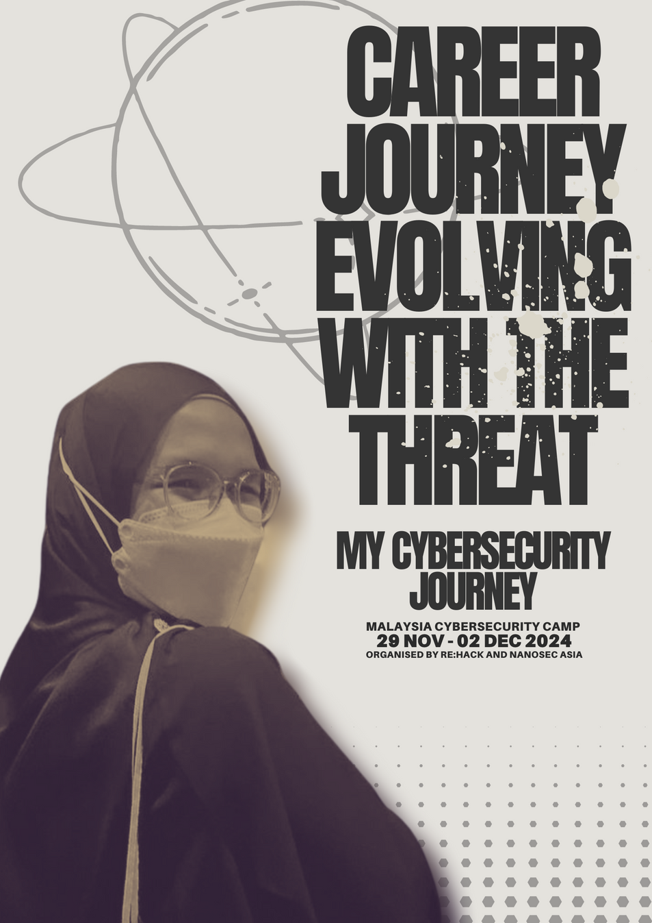

Slide 2

DATE
29/11/2024
CAREER JOURNEY EVOLVING WITH THE THREAT
MY CYBERSECURITY JOURNEY
PRESENTED BY
AIN

Slide 3


DISCLAIMER
Just a quick note: the stuff I'm about to share is all my own thoughts and opinions. It doesn't necessarily reflect the views of my company.

Slide 4

DISCLAIMER 2.0
Just a quick, quick note: A couple of slides are for viewing only, so no recording please.

Slide 5
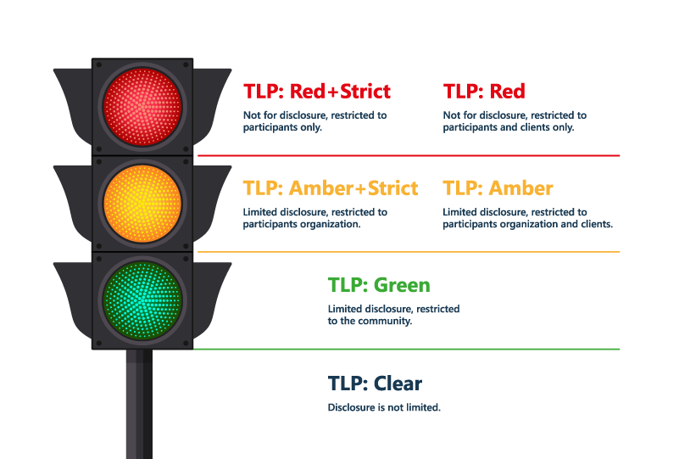
TRAFFIC LIGHT PROTOCOL
https://envisionit.com/

Slide 6
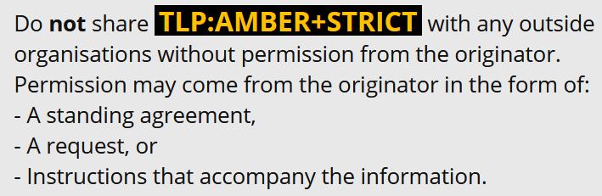
TRAFFIC LIGHT PROTOCOL
https://www.first.org/tlp/use-cases

Slide 7

WHOAMI
01
NAME
04
HOBBY
Ain
Video games
02
WORK EXPERIENCE (PAST)
SOC Analyst at MyGSOC
03
WORK EXPERIENCE (PRESENT)
05
PROFESSIONAL CERTIFICATIONS
Security Analyst at CyberSecurity Malaysia
COMPTIA CYSA+
ISC2 CC
GLOBAL ACE CSOC
GCTI

Slide 8
WHAT DO THE EXPERIENCE AND CERTIFICATES TELL ABOUT ME?
SOC Analyst at MyGSOC
Security Analyst at CyberSecurity Malaysia
COMPTIA CYSA+
ISC2 CC
GLOBAL ACE CSOC
GCTI

Slide 9
WHAT DO THE EXPERIENCE AND CERTIFICATES TELL ABOUT ME?
SOC Analyst at MyGSOC
Security Analyst at CyberSecurity Malaysia
COMPTIA CYSA+
ISC2 CC
GLOBAL ACE CSOC
GCTI

Slide 10
DISEBALIK KEJAYAAN,
ADA KEGAGALAN
CEHv8 2014
ISACA CYBERSECURITY FUNDAMENTALS

Slide 11

BEFORE THAT....

Slide 12
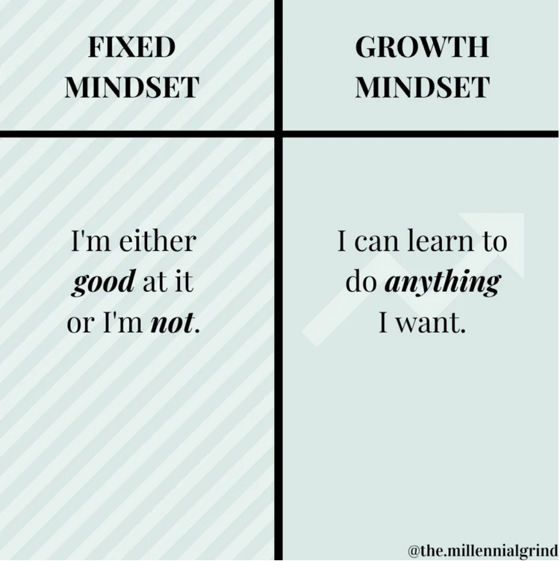
BEFORE THAT....

Slide 13
DISEBALIK KEJAYAAN,
ADA KEGAGALAN
CEHv8 2014
ISACA CYBERSECURITY FUNDAMENTALS

Slide 14
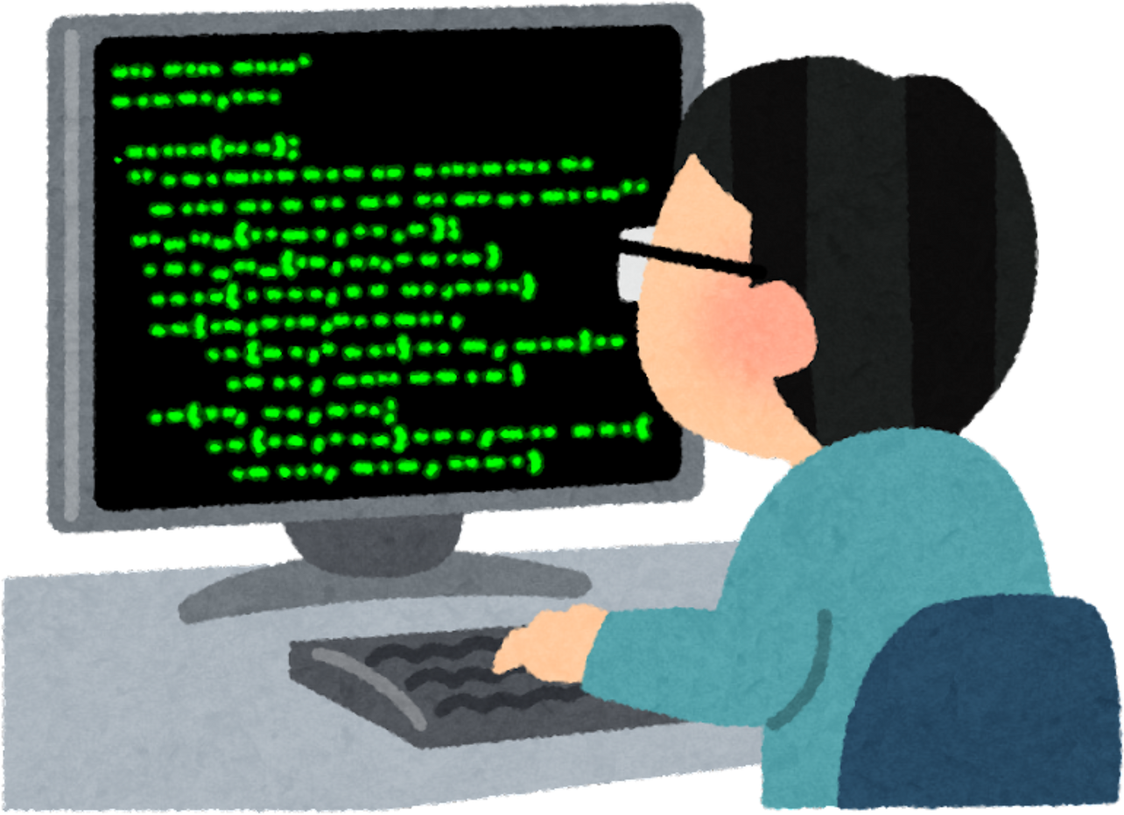
WORK EXPERIENCE
(past)
03
SOC ANALYST
Work in shift
Monitoring
1st level escalation
Ticket management
Prepare reports

Slide 15



WORK EXPERIENCE
(past)
INCIDENT RESPONDER IN CERT
04
COMPUTER EMERGENCY RESPONSE TEAM
Incidents reported to Cyber999
Produce reports and statistics
Alerts and advisories

Slide 16
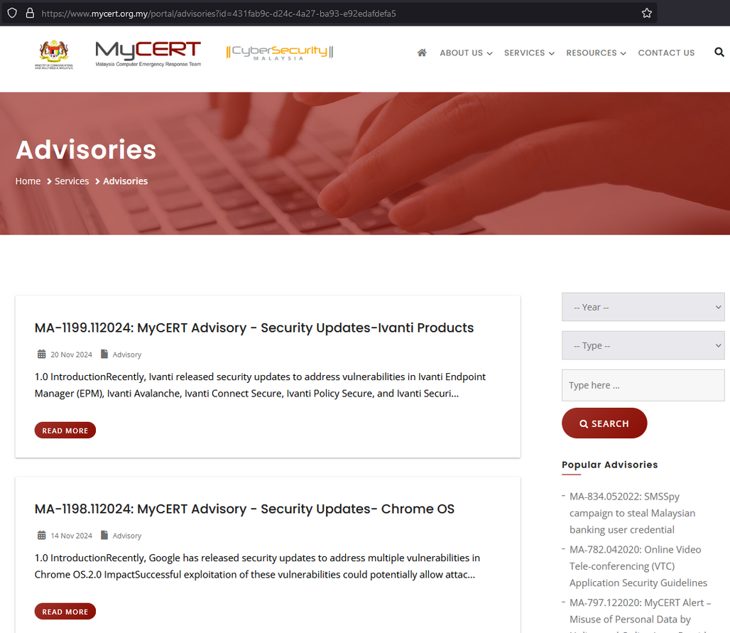
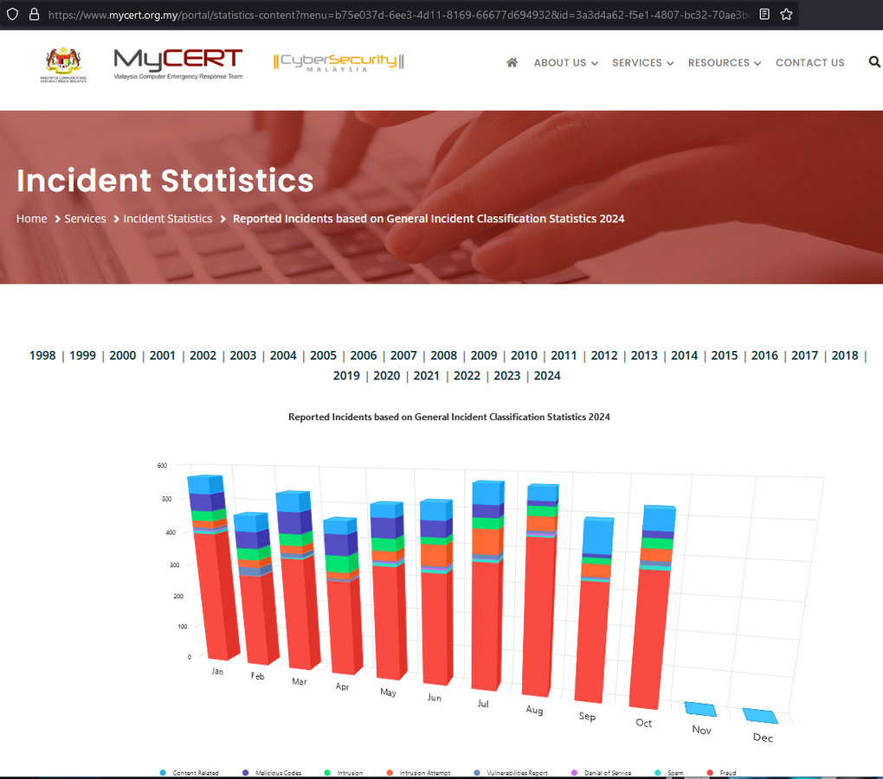
WORK EXPERIENCE
(past)
04
Spam
Intrusion
Cyber harassment (past)
Vulnerabilities report
Intrusion attempt
Denial of service
Malicious codes
Content related
Fraud

Slide 17
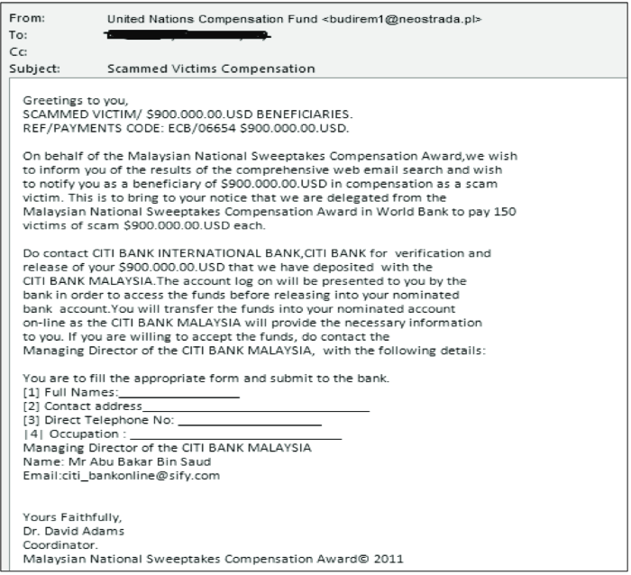
Spam

Slide 18
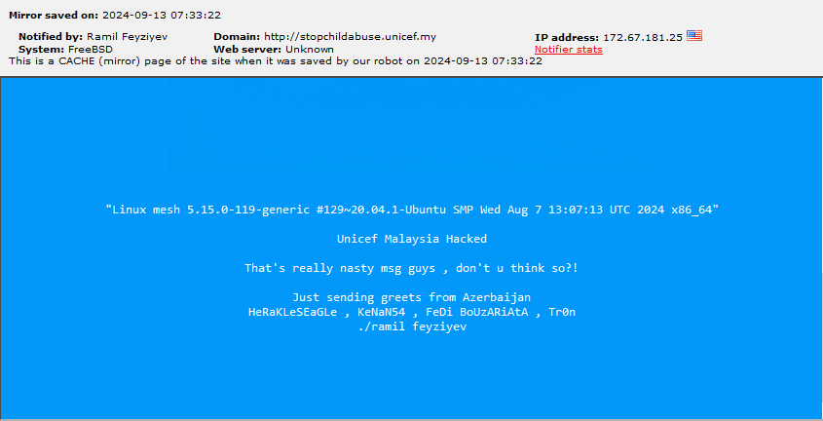
Intrusion
http://www.zone-h.org/mirror/id/41282342

Slide 19
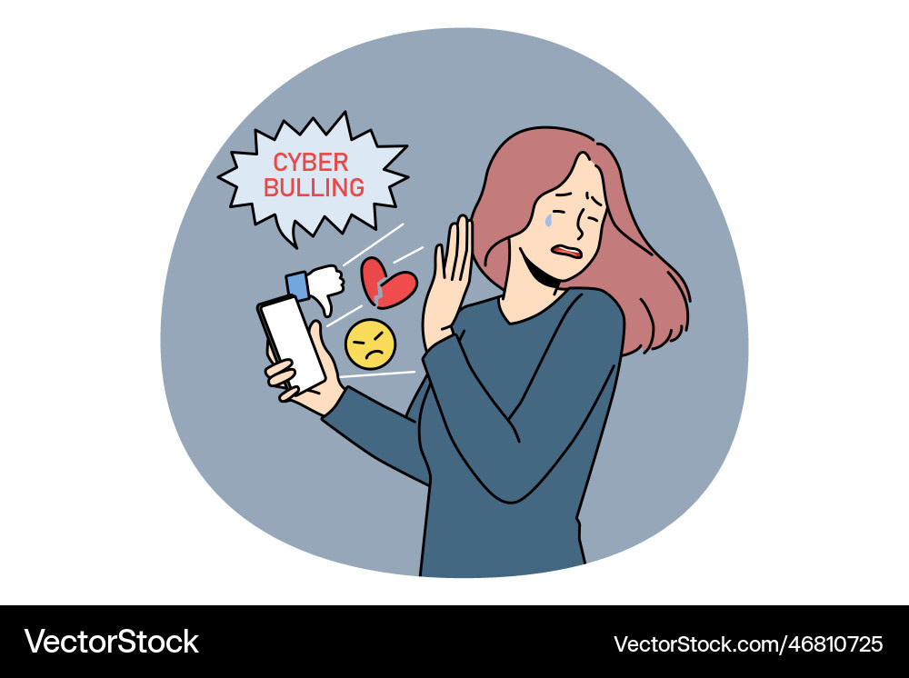
Cyber harassment (past)

Slide 20


Vulnerabilities report

Slide 21
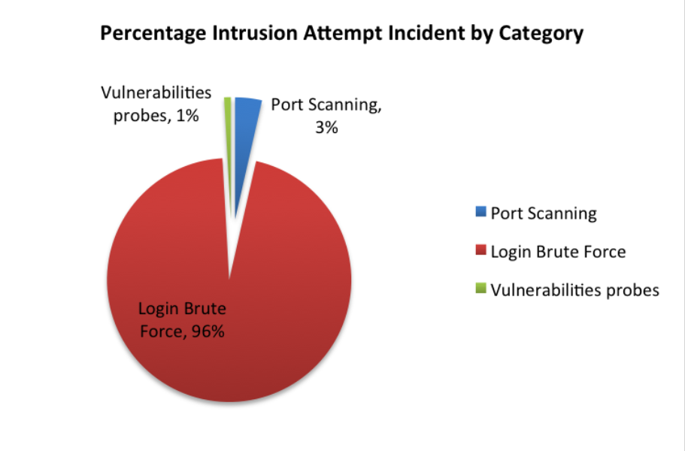
Intrusion attempt
https://mycert.org.my/portal/readpub?doc=..%2F..%2Fcommon%2Fuploads%2Fpublications%2F-S3Xy5lylh-uujS4ZXHi_20190513040634.pdf

Slide 22
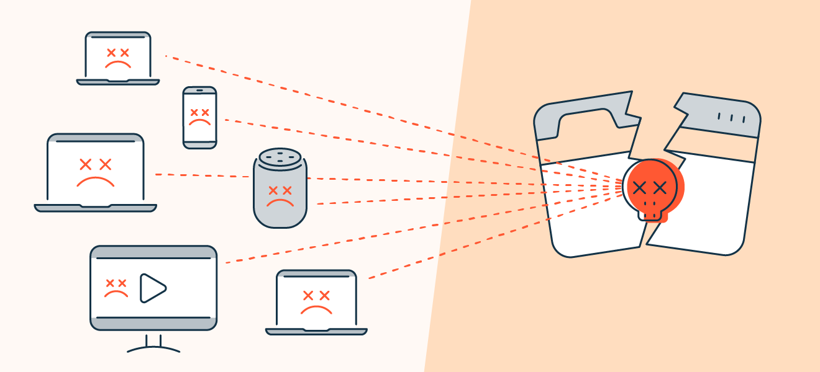
Denial of service
https://www.avast.com/c-ddos

Slide 23
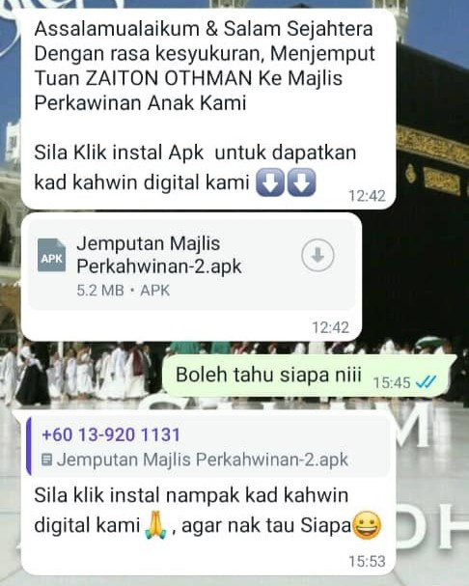
Malicious codes
https://www.mycert.org.my/portal/details?menu=431fab9c-d24c-4a27-ba93-e92edafdefa5&id=1d7aff3a-492f-435a-9d2c-f5d2dc5bc8af
https://notes.netbytesec.com/2023/06/kahwin-sms-stealer-target-Malaysia.html

Slide 24
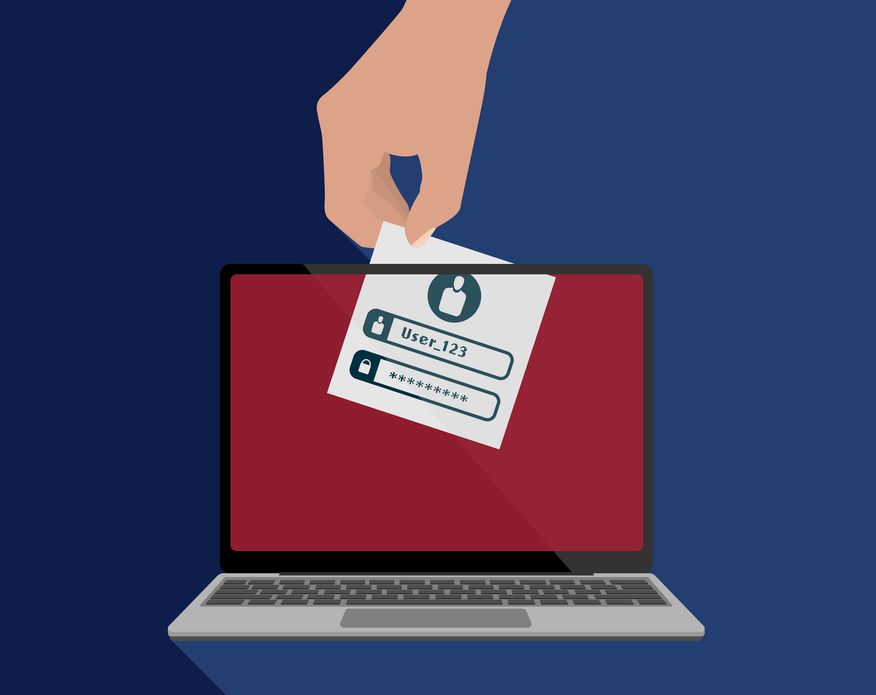
Content related
https://www.ncsc.gov.uk/guidance/data-breaches

Slide 25
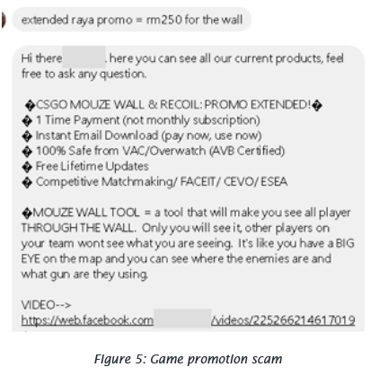
Fraud
https://www.mycert.org.my/portal/publicationdoc?id=cf0fb8e4-43fc-4b21-a90e-5570181958b3

Slide 26

WORK EXPERIENCE
(past)
CSIRT CONSULTANCY
04
Computer Security Incident Response Team (CSIRT)
Incident response planning
Provide training

Slide 27

WORK EXPERIENCE
SPEAKER
04
Mainly for KPI
local and international
Except during covid

Slide 28

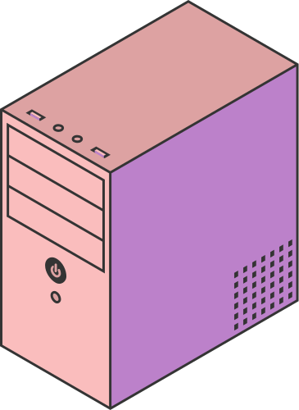
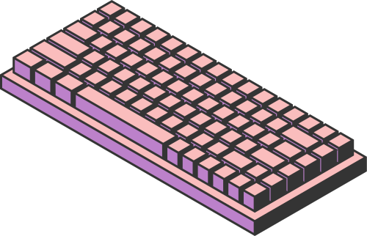
WORK EXPERIENCE
EXCON CYBER DRILL
04
Exercise Controller
Develop scenario

Slide 29
WORK EXPERIENCE
CYBER DRILL
some use ctf style challenge
04
AP-CERT Drill
ACID Drill
OIC-CERT Drill
Africa-CERT Drill
ITU-Drill

Slide 30
WORK EXPERIENCE
CYBER BATTLE
04
Standoff Cyberbattle (Red vs Blue)
Taiwan CODE (Attack vs Defend)
SANS NetWars

Slide 31
WHY DID THE CYBERSECURITY ANALYST BRING A LADDER TO THE SOC?
To get a higher-view of the threat landscape

Slide 32
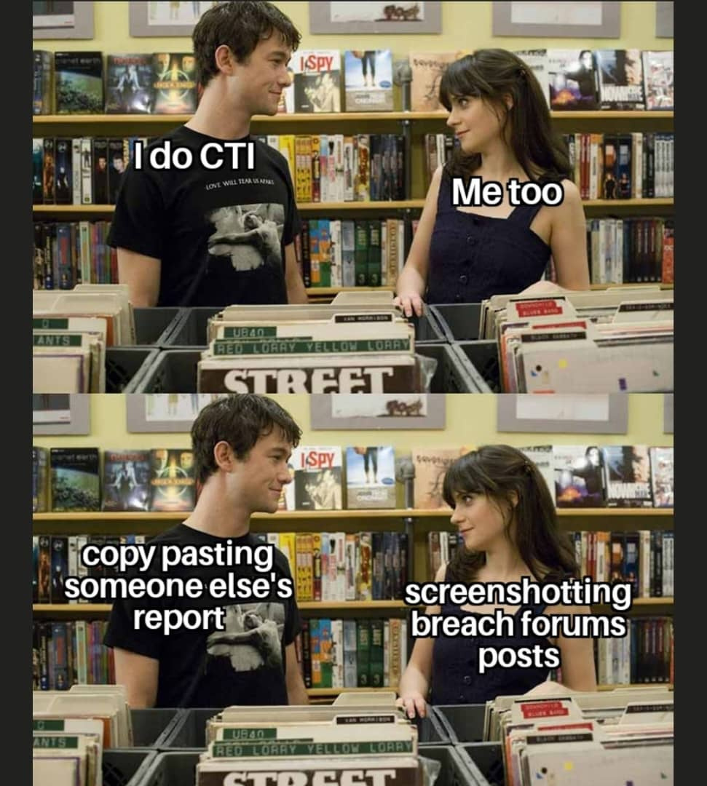

Slide 33
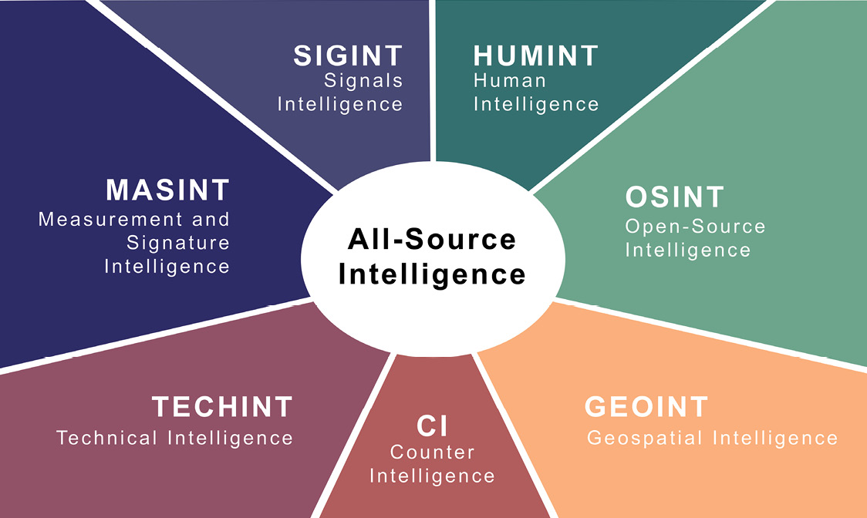
https://tjaglcs.army.mil/Periodicals/The-Army-Lawyer/tal-2022-issue-4/Post/4255/No-1-Distinguishing-Between-Operational-and-Intelligence-Activities

Slide 34
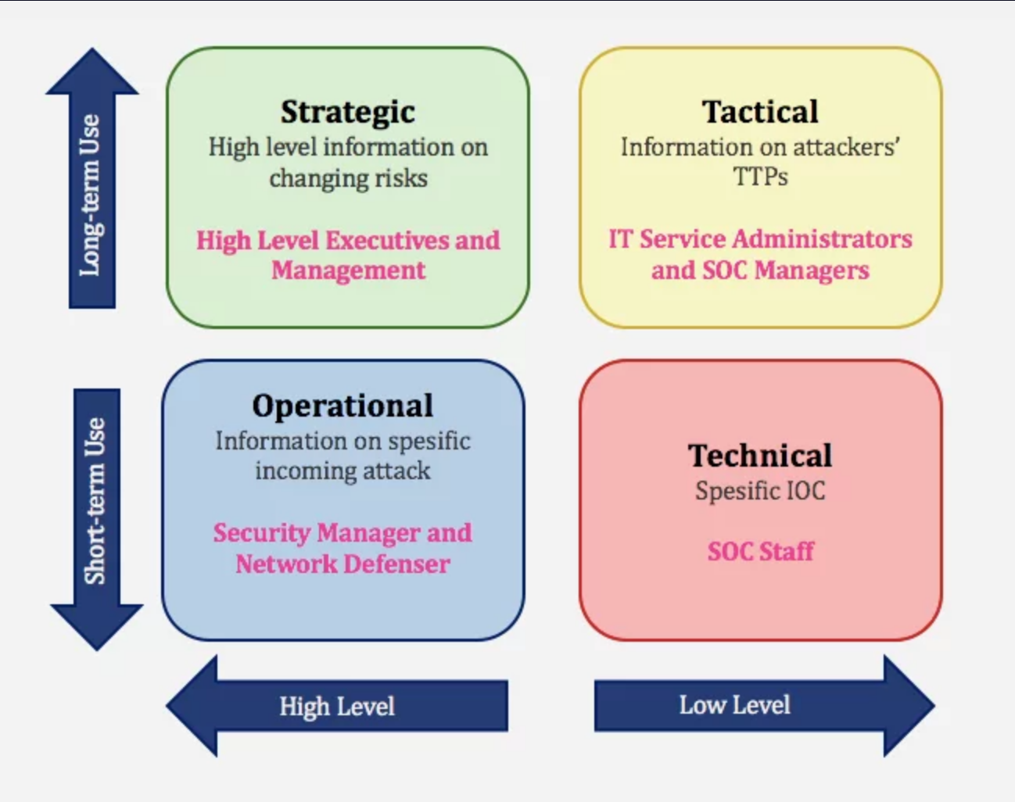
https://socradar.io/what-is-tactical-cyber-threat-intelligence-and-how-to-use-it/

Slide 35
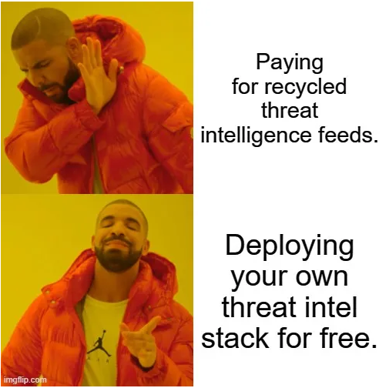
CTI AT MYCERT
Enriching the SOC
Credit https://socfortress.medium.com/part-10-misp-threat-intel-68131b18f719:

Slide 36

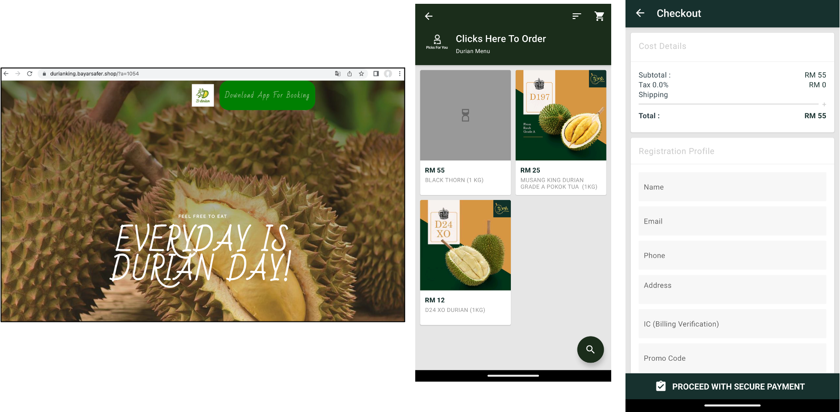
MALICIOUS DURIAN APK

Slide 37
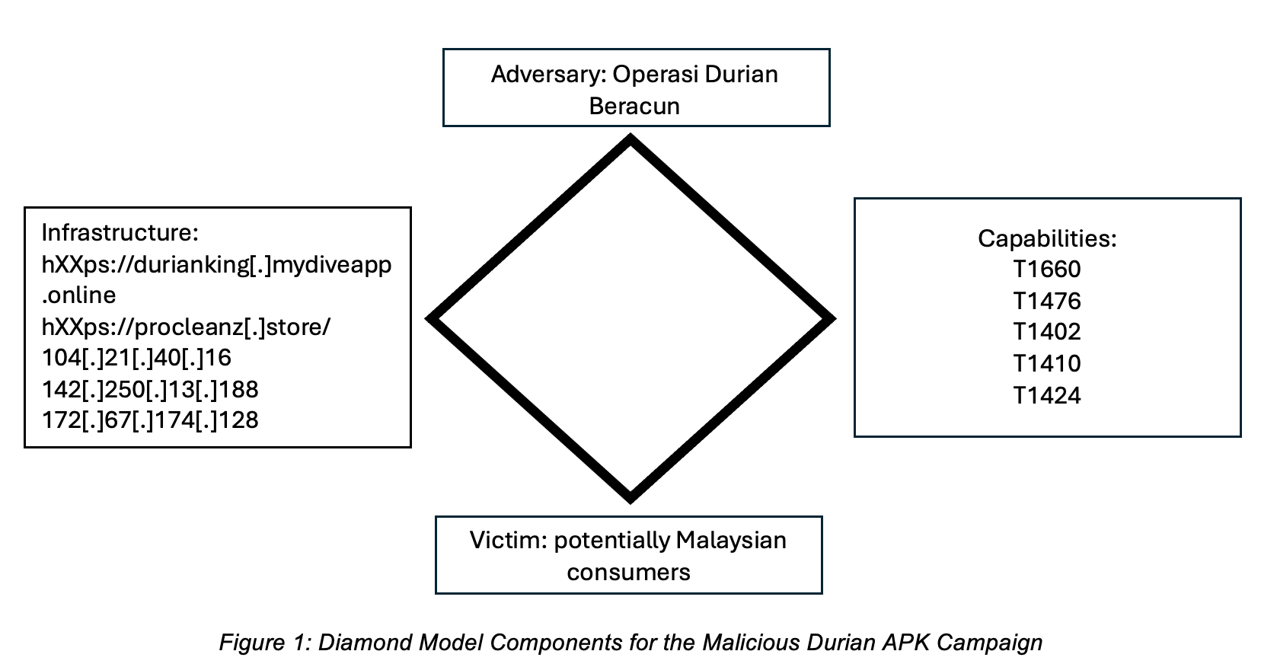

Slide 38
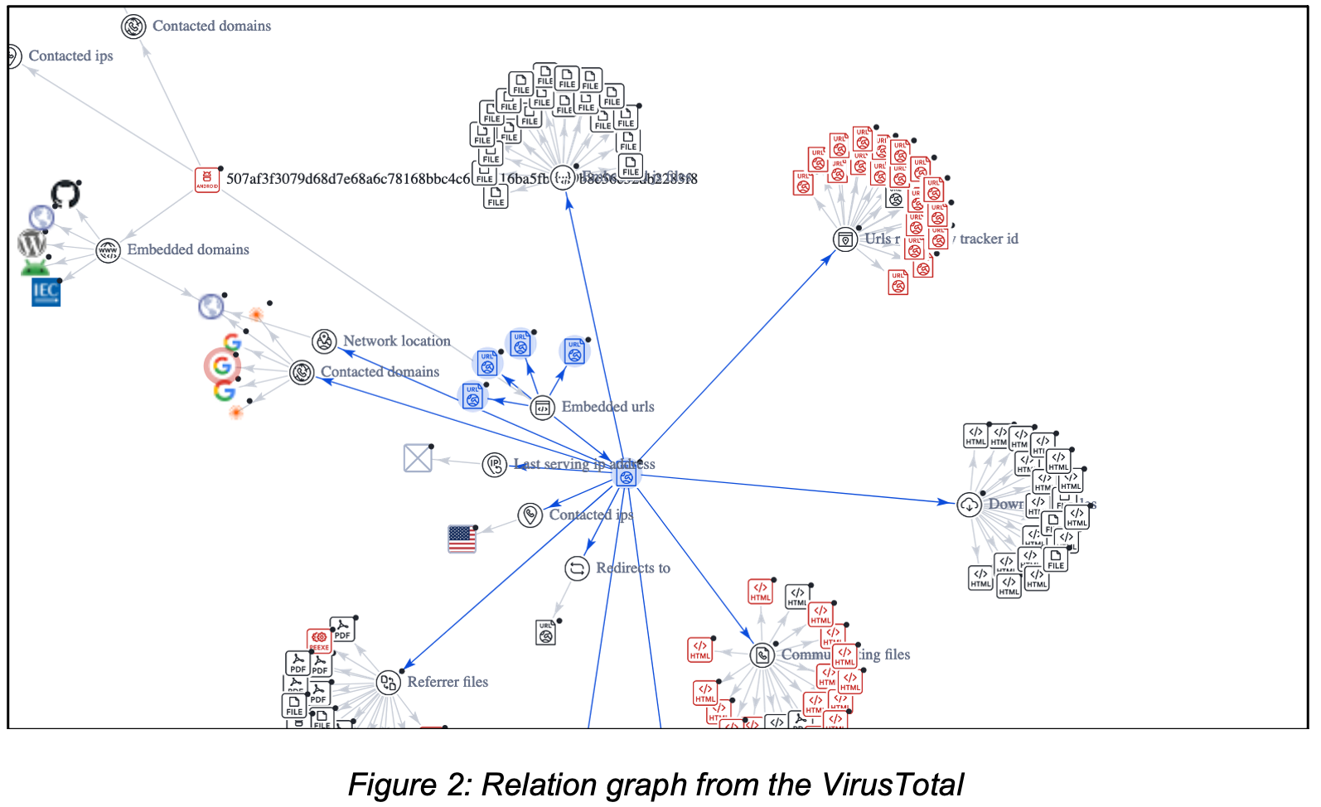

Slide 39
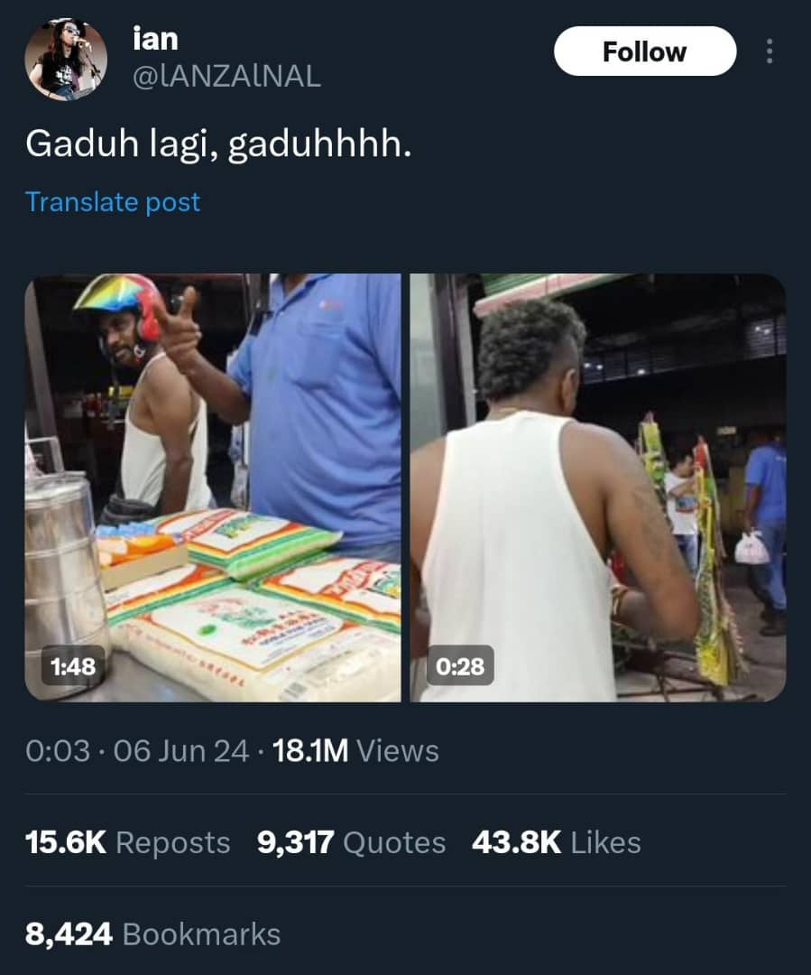
REMEMBER THIS VIRAL VIDEO?

Slide 40
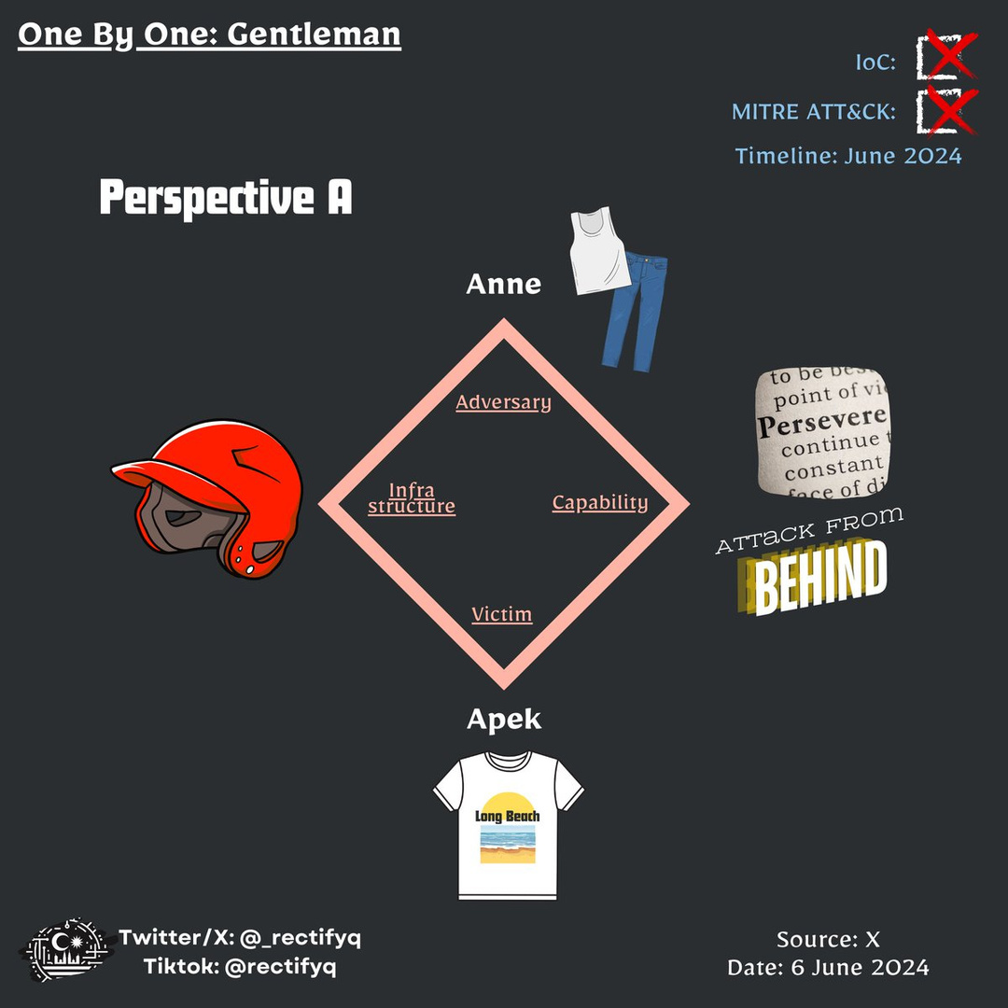
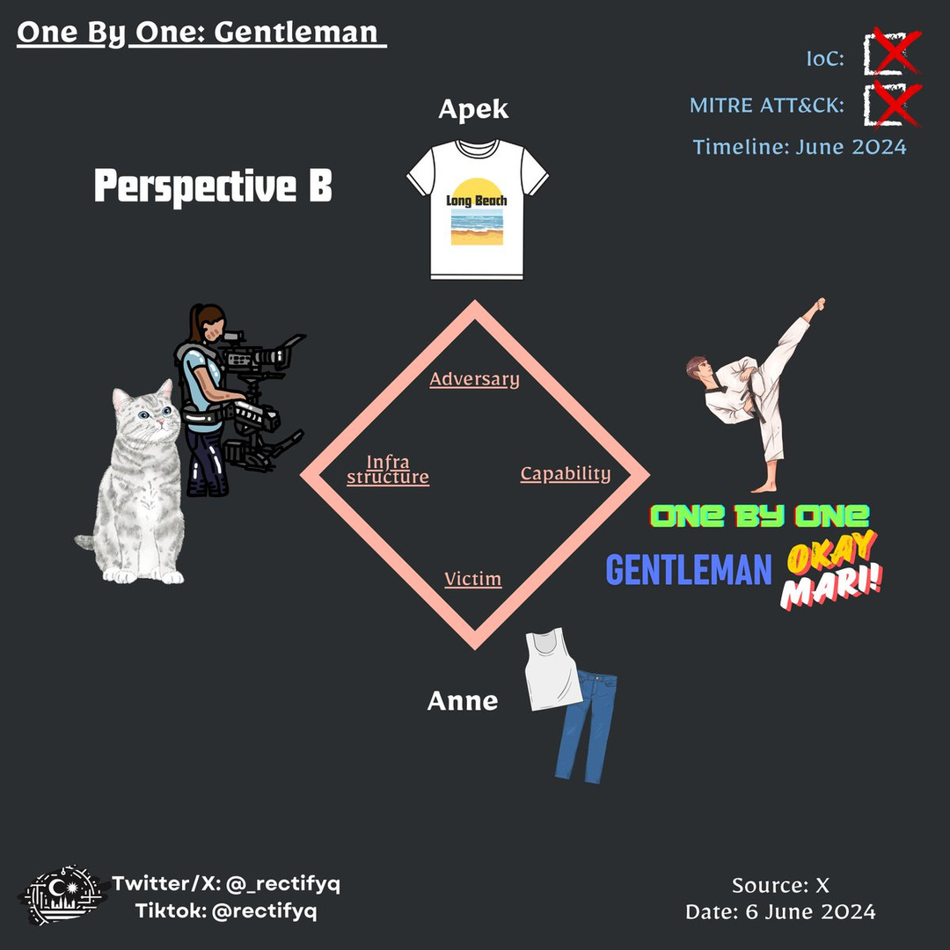

Slide 41
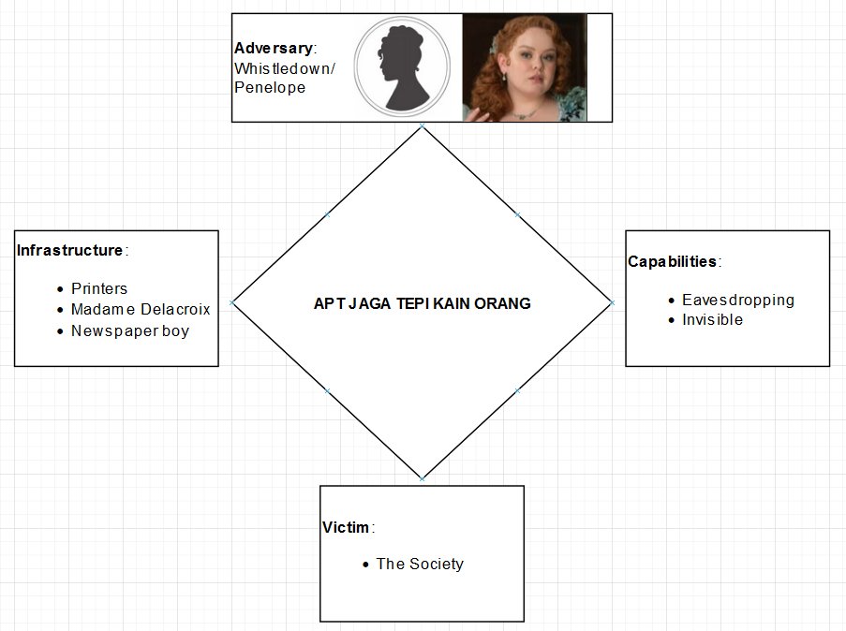
If you watched The Bridgerton

Slide 42
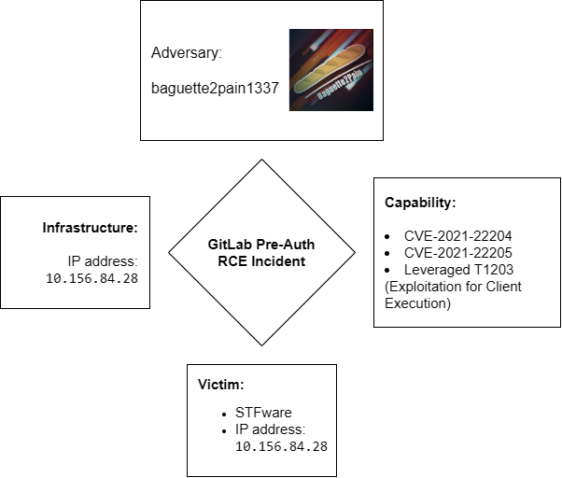
From the Standoff 14 Cyberbattle - Day 4 (today!)
Credit to my team: https://www.linkedin.com/in/lukmanhar94

Slide 43
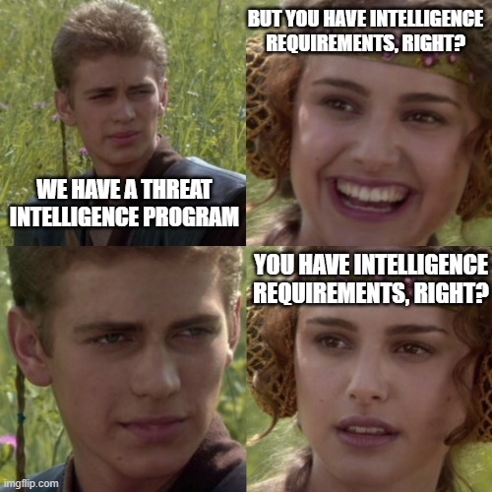
INTELLIGENCE IS DEPENDS ON REQUIREMENTS
Threat intelligence is a dynamic and adaptive field that relies on specific needs and priorities.
Credit: X @BrianPKime

Slide 44

Malaysia’s Cyber Threat Landscape by the Cyber Risk Intelligence team
https://www.cybersecurity.my/data/content_files/26/2511.pdf

Slide 45
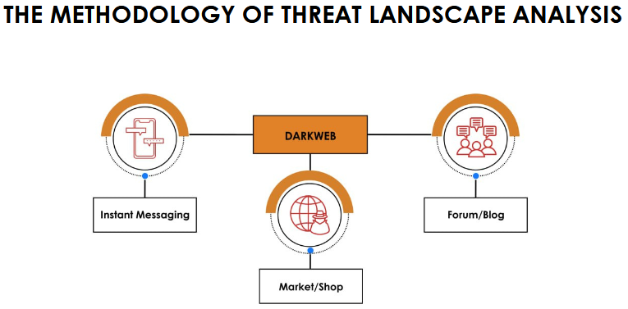
https://www.cybersecurity.my/data/content_files/26/2511.pdf

Slide 46
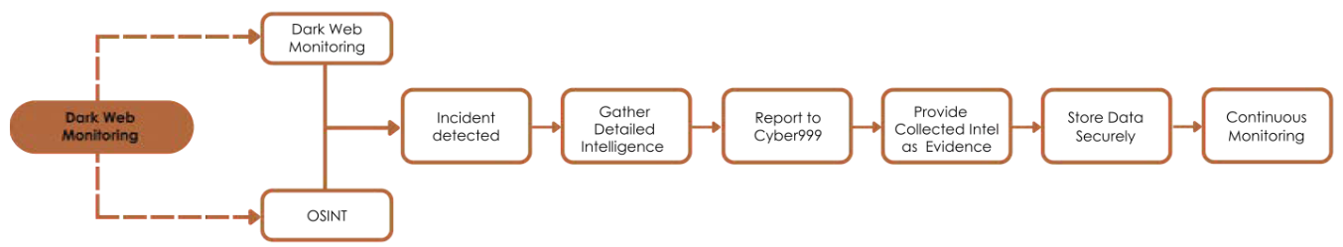
https://www.cybersecurity.my/data/content_files/26/2511.pdf

Slide 47
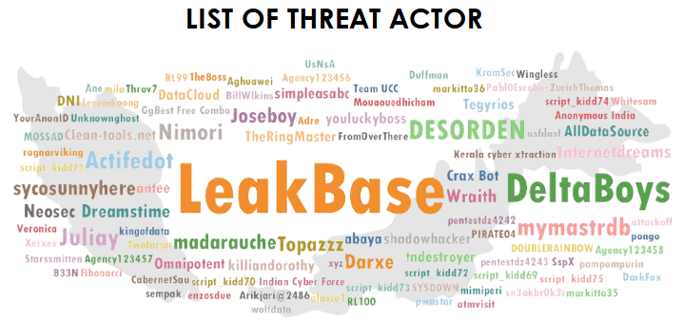
https://www.cybersecurity.my/data/content_files/26/2511.pdf

Slide 48
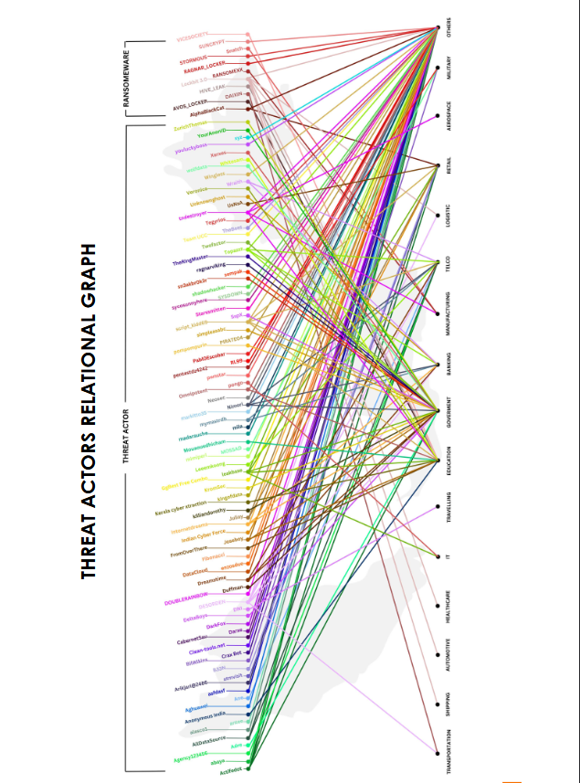
https://www.cybersecurity.my/data/content_files/26/2511.pdf

Slide 49
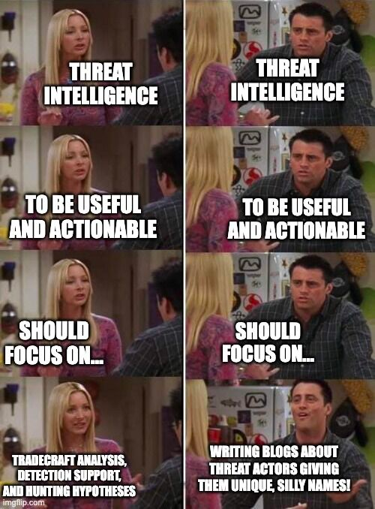
INTERESTED IN THREAT INTEL?
Whether you’re red team or blue - anyone can pursue!
Street smart or book smart? - both are valuable.
https://www.linkedin.com/posts/joe-slowik_cti-threatintelligence-activity-7134935817541611520-0CkX/

Slide 50
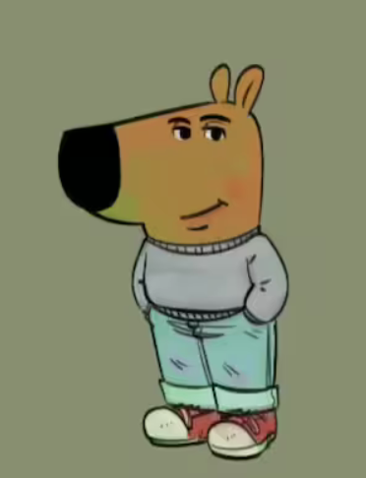
TAKEAWAYS
Find your person - sharing and involve
Push through
Improve both technical skills and soft skills
01
02
03

Slide 51
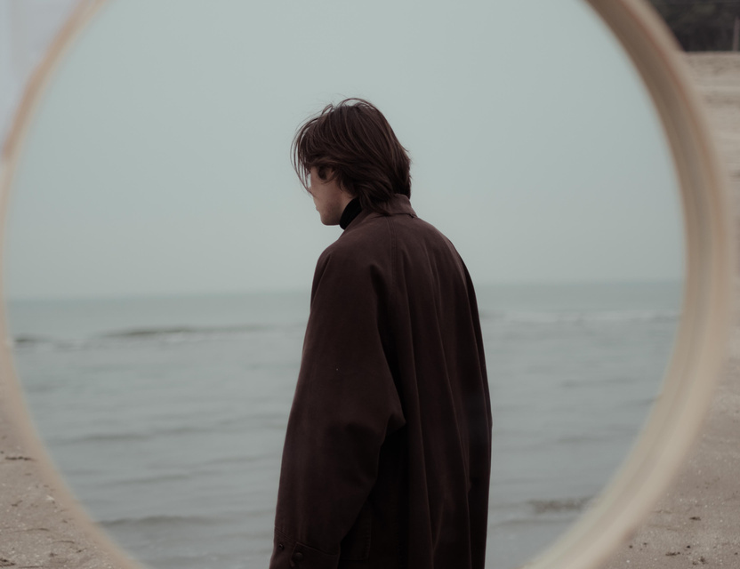
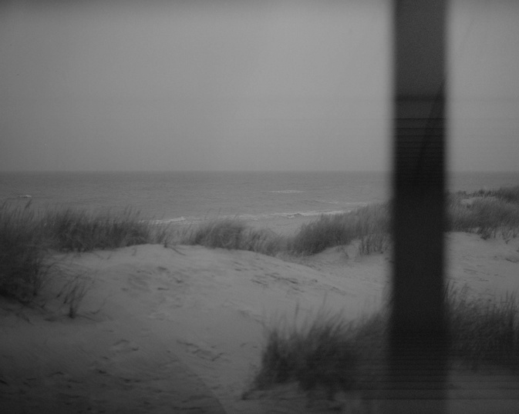
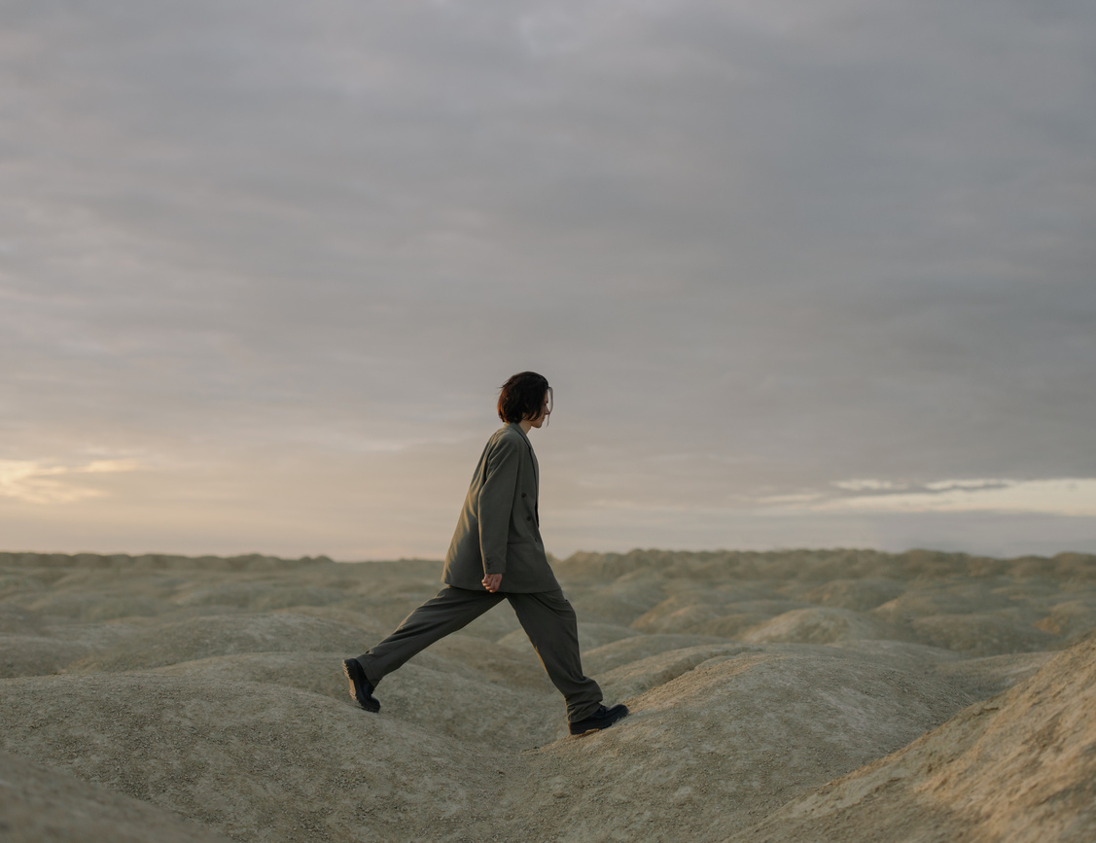
BONUS

Slide 52
EMOTION-FOCUSED COPING MECHANISM
Tool: Pause, Deep breathing, Tapping

Slide 53
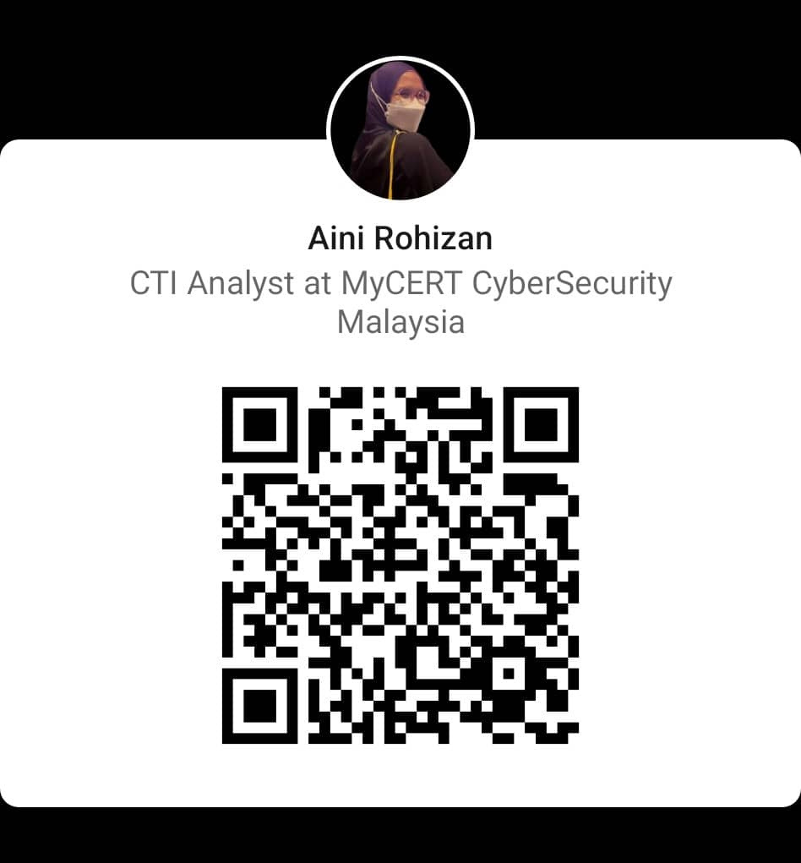
LET’S KEEP IN TOUCH!
LinkedIn
Aini Rohizan

